Slide 1
INFANT DEVELOPMENT

Slide 2
OBJECTIVE

Slide 3
BABY / CHILDHOOD DEVELOPMENT
Physical
Intellectual
Emotional

Slide 4
COGNITIVE DEVELOPMENT
There have been identified four stages of development in normal intellectual development, from infancy through adulthood.
Each stage is marked by new intellectual abilities and a more complex understanding of the world.
There are developmental milestones.

Slide 5
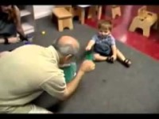
Example - Cognitive development in toddlers
https://www.youtube.com/watch?v=NCdLNuP7OA8

Slide 6
Gross and Fine Motor Skills
Muscular development is vital human development.
Gross motor skills involve the bigger muscles and control the overall structure and function of the body.
Fine motor skills work the smaller muscles of the hands, fingers, and wrists. Fine motor skills are about dexterity and associated the development many intellectual skills.

Slide 7
Milestones Gross Motor skill development
0–3 months
Developing hand-eye coordination, lifting their head and chest.
3–6 months
Roll from their back to their side, head control.
6–9 months
Back and abdominal muscles get stronger, start slide and crawl.
1 year
Walking without help.
2 years
Start to run and jump
3 to 5 years
Stronger leg muscles, improved balance, child is ready to learn how to catch, skate and swim.

Slide 8
Milestones Fine Motor skill development
0 – 6 months
Reaching and grasping
6-12 months
Reach for, grasp, drop and pickup objects
1-2 years
Hold cups, turn pages, string beads.
2-3 years
Manipulate objects, build, cut, squeeze
3-4 years
Write numbers and names, dress and undress.
4-5 years
Cut simple shapes, controlled coloring, draw basic pictures
5-6 years
Correct formation of letters, numbers and drawings.
6-8 years
Consistency and endurance of writing

Slide 9
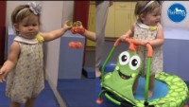
https://www.youtube.com/watch?v=bzblC_pT8t0

Slide 10
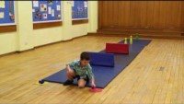
https://www.youtube.com/watch?v=0SYx95xdGTo

